Slide 1

Professional Business & Finance Slides
Get 10% off our PowerPoint for Business & Finance Course using coupon code EMAIL10
Get Our PowerPoint for Business & Finance Course
Made by Kenji Explains / Career Principles
Note: All content is copyright material of Kenji Explains / Career Principles. This file may not be reproduced or distributed by any means, including printing, screen capturing, or any other method without the prior permission of the publisher

Slide 3

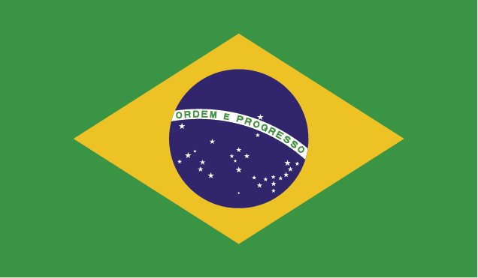


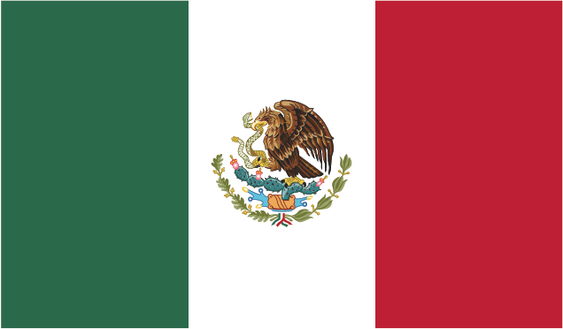


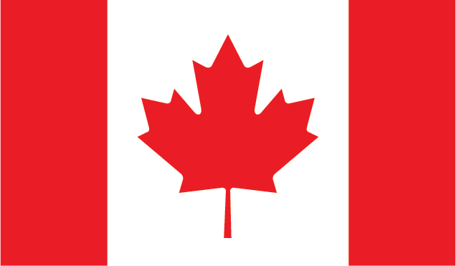
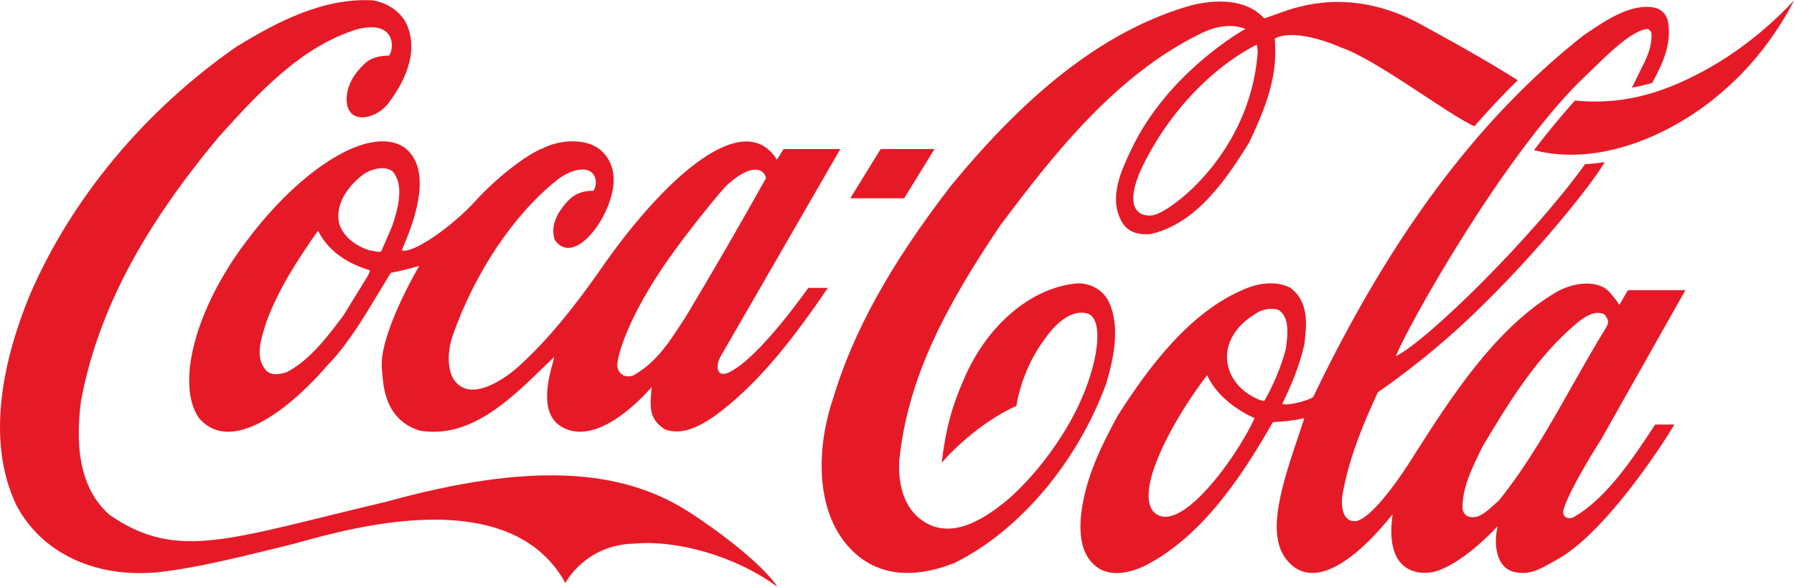
Supporting Text & Graphics
United States | 13,010
Mexico | 8,556
United Kingdom | 7,589
Canada | 7,358
Japan | 5,428
Brazil | 5,401
The United States sparkling soft drinks market has seen 12% growth YoY from 2012-2021
Beverage regulations in the European Union slashed EU growth expectations to less than 1.5% in 2022
“The soft drinks market has seen the massive regulatory hurdles in Europe”
- Sam Smith, Bloomberg Europe
Sources: Bloomberg News; CNBC Americas
“Coca-Cola has solidified it’s position as market leader in the United States despite intense competition”
- Martha Warren, CNBC Americas

Slide 5
Supporting Text & Graphics
State | Revenue in millions
New York | 465
Texas | 585.9
California | 644.8
Illinois | 489.8
Pennsylvania | 511.5
Nevada | 446.4
Colorado | 319.3
Washington | 269.7
Florida | 585.9
Minnesota | 176.7
Montana | 179.8
Tennessee | 210.8
Nebraska | 167.4
Alabama | 269.7
Maine | 303.8
Alaska | 207.7
Hawaii | 210.8
Wyoming | 179.8
Virginia | 207.7
Michigan | 142.6
Missouri | 151.9
Utah | 151.9
Oregon | 207.7
Louisiana | 244.9
Idaho | 114.7
Arizona | 148.8
New Mexico | 213.9
Georgia | 275.9
South Carolina | 269.7
North Carolina | 257.3
Ohio | 303.8
Kentucky | 207.7
Mississippi | 241.8
Arkansas | 210.8
Oklahoma | 179.8
Kansas | 148.8
South Dakota | 148.8
North Dakota | 148.8
Iowa | 145.7
Wisconsin | 151.9
Indiana | 170.5
West Virginia | 207.7
Maryland | 334.8
Delaware | 337.9
New Jersey | 341
Connecticut | 232.5
Rhode Island | 272.8
Massachusetts | 300.7
Vermont | 254.2
New Hampshire | 306.9
State | Population (millions) | Revenue (millions) | Profit Margin (%)
CA | 39.4M | $2,500 | 25.6%
TX | 28.6M | $1,850 | 26.8%
FL | 21.2M | $1,785 | 24.4%
PA | 12.79M | $1,105 | 26.2%
IL | 12.72M | $1,103 | 24.2%
NV | 3.03M | $848 | 32.5%
NJ | 8.89M | $841 | 29.4%
NY | 8.38M | $796 | 28.0%
Source: Statista population by state report 2021

Slide 7
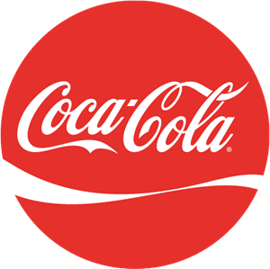
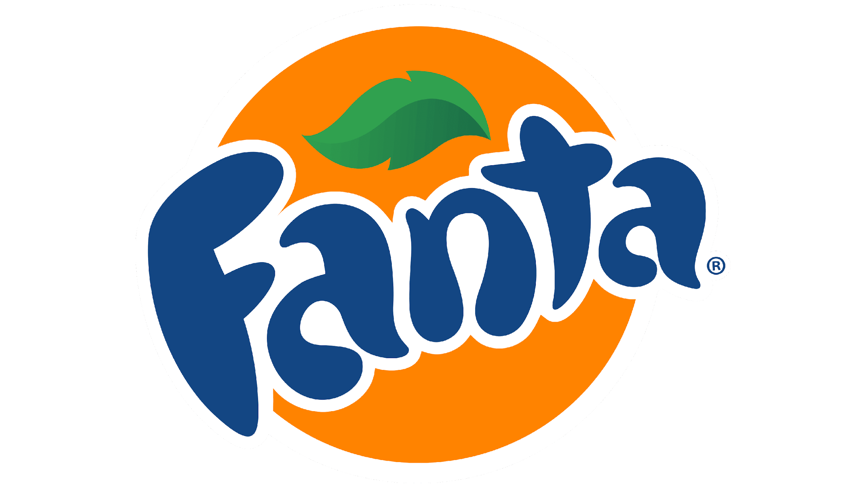
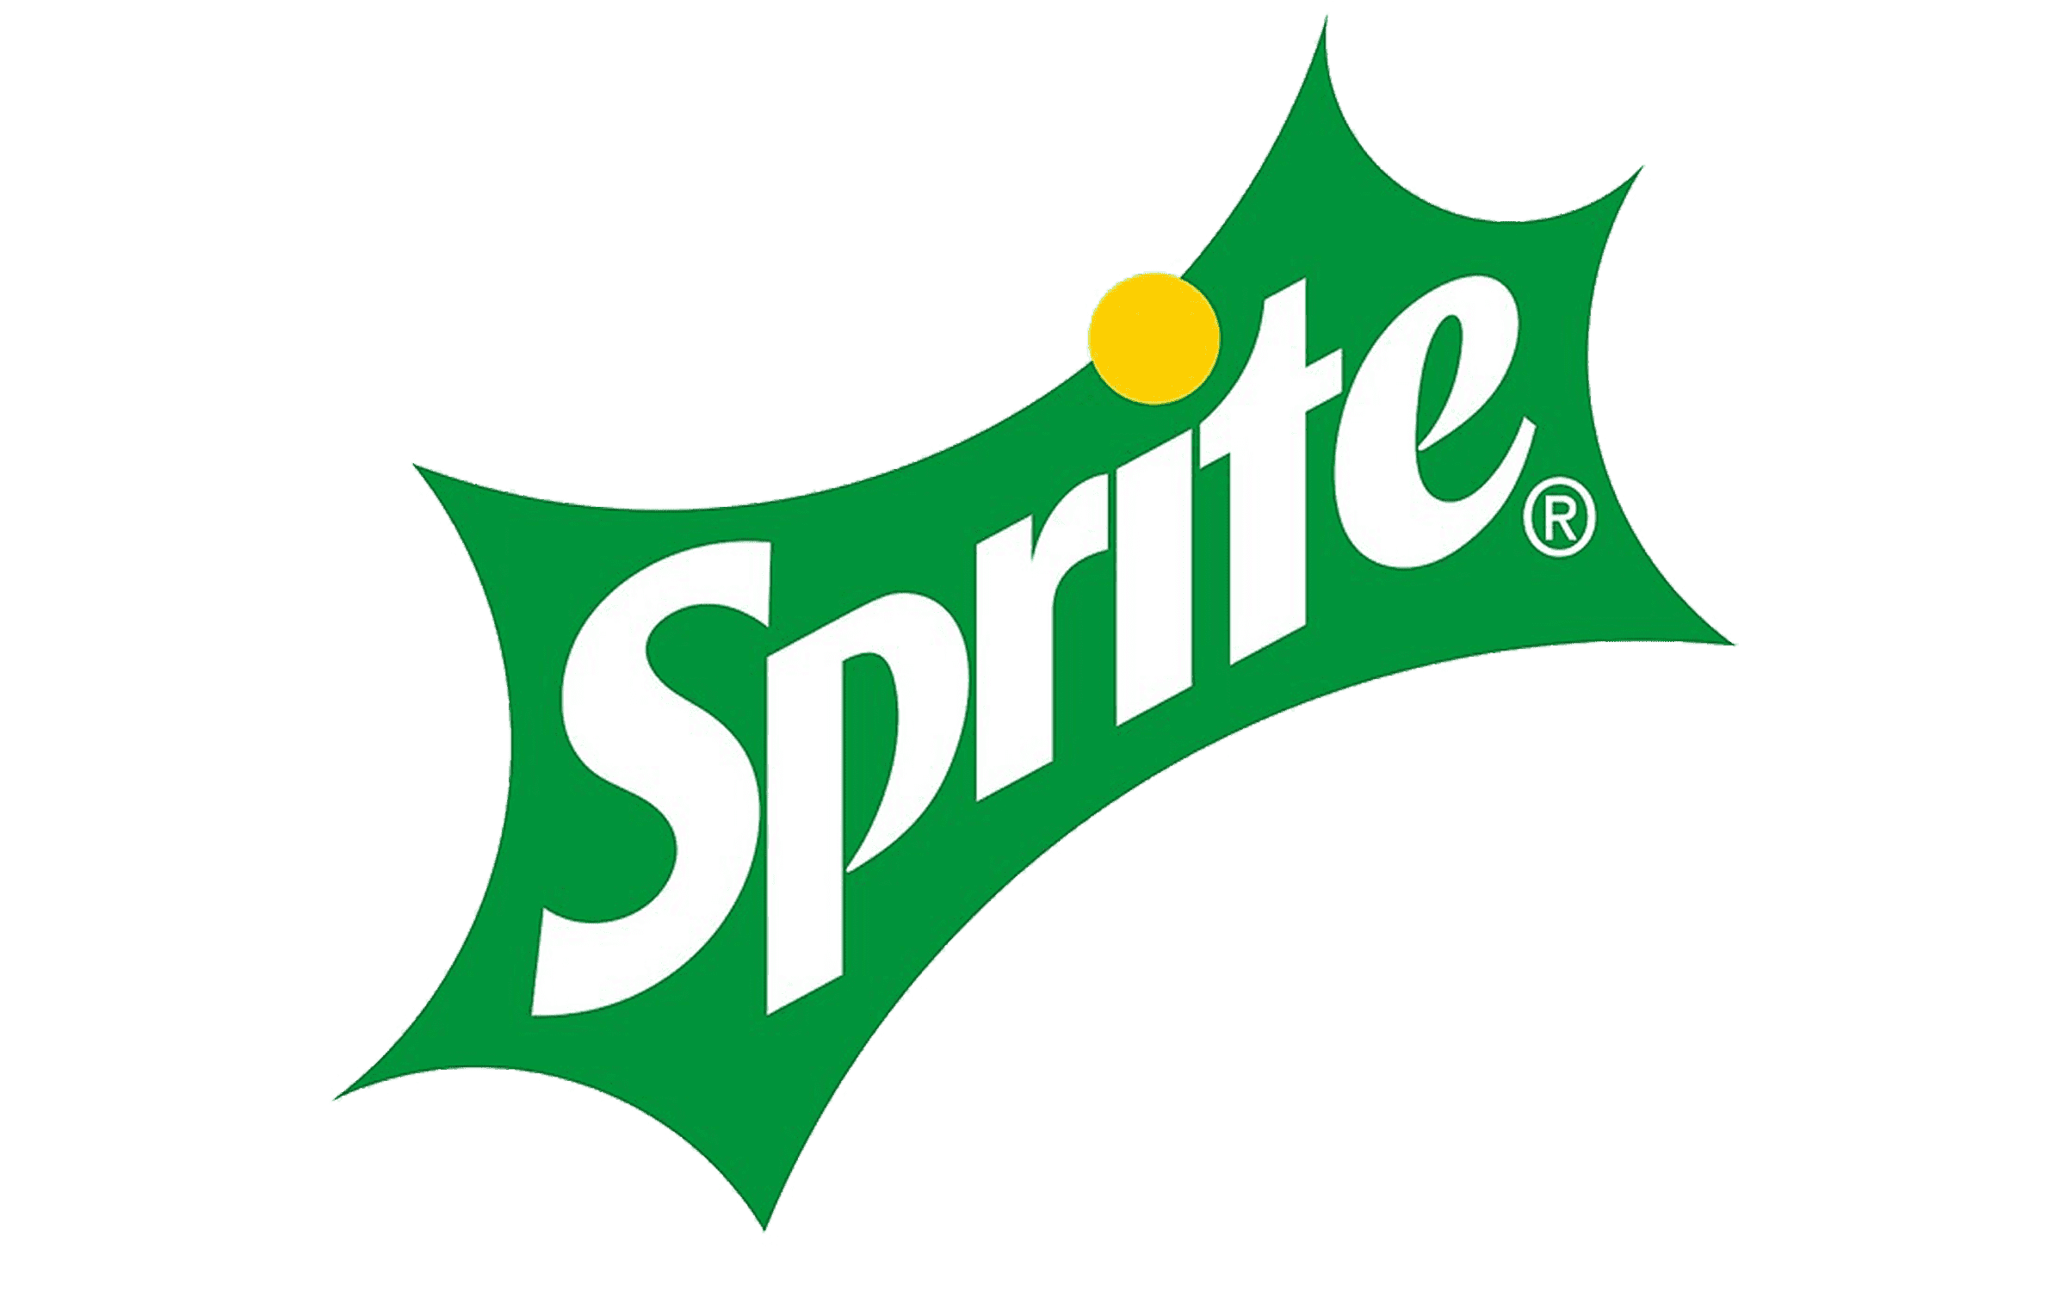
Supporting Text & Graphics
All Coca-Cola brands in the US show revenue growth of over 15% from 2020-2021
Boosted by the inflationary trends, the top three brands by revenue are Coca-Cola, Fanta, and Sprite, with the latter recording an all-time high $3.9B in revenue in 2021
Year | Fanta | Coca-Cola | Sprite
2020 | $3.0B | $6.0B | $3.0B
2021 | $4.5B | $7.2B | $3.9B
Source: Coca-Cola Website - https://www.coca-colacompany.com/brands

